Slide 1
Unit :IV

Slide 2
Searching
The process used to find the location of a target among a list of objects
Searching an array finds the index of first element in an array containing that value

Slide 3
successful

Slide 4
unsuccessful

Slide 5
Unordered Linear Search
Search an unordered array of integers for a value and return its index if the value is found. Otherwise, return -1.
A[0] A[1] A[2] A[3] A[4] A[5] A[6] A[7]
Algorithm:
Start with the first array element (index 0)
while(more elements in array){
if value found at current index, return index;
Try next element (increment index);
}
Value not found, return -1;
14 2 10 5 1 3 17 2

Slide 6
Unordered Linear Search
// Searches an unordered array of integers
int search(int data[], //input: array
int size, //input: array size
int value){ //input: search value
// output: if found, return index;
// otherwise, return –1.
for(int index = 0; index < size; index++){
if(data[index] == value)
return index;
}
return -1;
}

Slide 7
Unordered Linear Search
#include <stdio.h>
int main() {
int array_size = 8;
int list[array_size]={14,2,10,5,1,3,17,2};
int search_value;
printf( "Enter search value: “);
scanf(%d,&search_value);
x=search(list,array_size,search_value)
printf(x);
return 0;
}

Slide 8
Ordered Linear Search
Search an ordered array of integers for a value and return its index if the value is found; Otherwise, return -1.
A[0] A[1] A[2] A[3] A[4] A[5] A[6] A[7]
Linear search can stop immediately when it has passed the possible position of the search value.
1 2 3 5 7 10 14 17

Slide 9
Ordered Linear Search
Algorithm:
Start with the first array element (index 0)
while(more elements in the array){
if value at current index is greater than value, value not found, return –1;
if value found at current index, return index;
Try next element (increment index);
}
value not found, return –1;

Slide 10
Ordered Linear Search
// Searches an ordered array of integers
int lsearch(int data[],// input: array
int size, // input: array size
int value // input: value to find
) { // output: index if found
for(int index=0; index<size; index++){
if(data[index] > value)
return -1;
else if(data[index] == value)
return index;
}
return -1;
}

Slide 11
ordered Linear Search
#include <stdio.h>
int main() {
int array_size = 8;
int list[array_size]={1,2,3,5,7,10,14,17};
int search_value;
printf( "Enter search value: “);
scanf(%d,&search_value);
x=lsearch(list,array_size,search_value)
printf(x);
return 0;
}

Slide 12
Searching for the pattern
Searching for the pattern of letters in a set of line

Slide 13
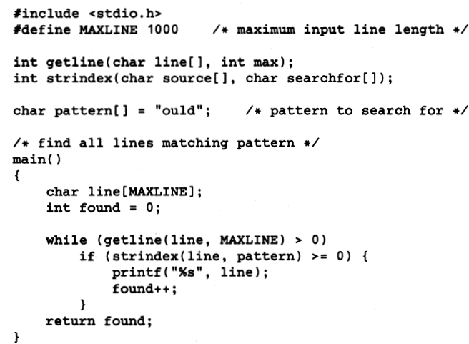

Slide 14
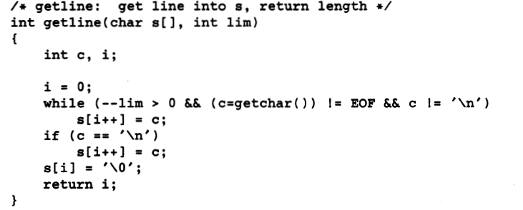

Slide 15
